Slide 1
Comprehensive Plan Amendments 2024 Annual Review Cycle
Spokane County Building & Planning

Slide 2
Comprehensive Plan Amendments
The Growth Management Act allows counties to amend their comprehensive plan once a year with the caveat that the county must consider the collective and cumulative impact of all proposed amendments on their impact on capital facilities and act on all proposed amendments simultaneously.
Spokane County Planning evaluated four new amendments and two continued from prior years for consideration by the Planning Commission —five propose to increase land availability or density for housing, one proposes to change rural lands to Regional Commercial.
The 2024 package includes proposed amendments submitted by the public.
Today’s Public Hearing is to take public testimony in support or opposition to recommendations for consideration these proposed amendments by the Planning Commission to the Board of County Commissioners.
Spokane County Building & Planning

Slide 3
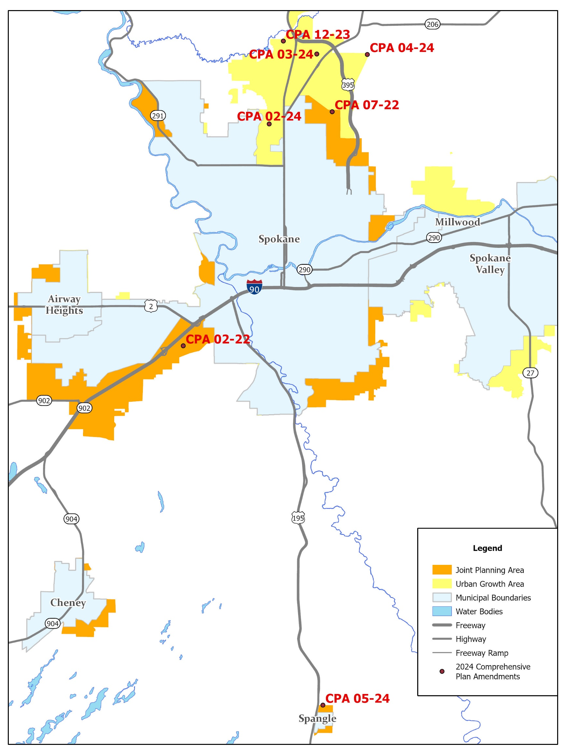
2024 Comprehensive Plan Amendments
Spokane County Building & Planning

Slide 4
2024 Proposed Plan Amendments
CPA-02-24 | 0.82 ac | Wall & Country Homes | LDR to HDR
CPA-03-24 | 2.97 ac | Hastings Farwell Corridor | LDR to HDR
CPA-04-24 | 5.22 ac | Mead area - Farwell and BNSF | LI to MDR
CPA-05-24 | 11.5 ac | North Spangle | RT to RC
CPA-02-22 | ±38 ac | West Plains - continued | LI to MU
CPA-07-22 | 45.49 ac | North Metro UGA - withdrawn | HI to RC
CPA-12-23 | 2.64 ac | North Mill Road - continued | LDR to MDR
Spokane County Building & Planning

Slide 5
Zoning Code Criteria for Amendment
Spokane County Code 14.402.040
The amendment is consistent with or implements the Comprehensive Plan and is not detrimental to public welfare.
A change in economic, technological, or land use conditions has occurred to warrant modification of the zoning code.
An amendment is necessary to correct an error in the zoning code.
An amendment is necessary to clarify the meaning or intent of the zoning code
An amendment is necessary to provide for a use(s) that was not previously addressed by the Zoning Code.
An amendment is deemed necessary by the Commission and/or Board as being in the public interest.
Spokane County Building & Planning

Slide 6
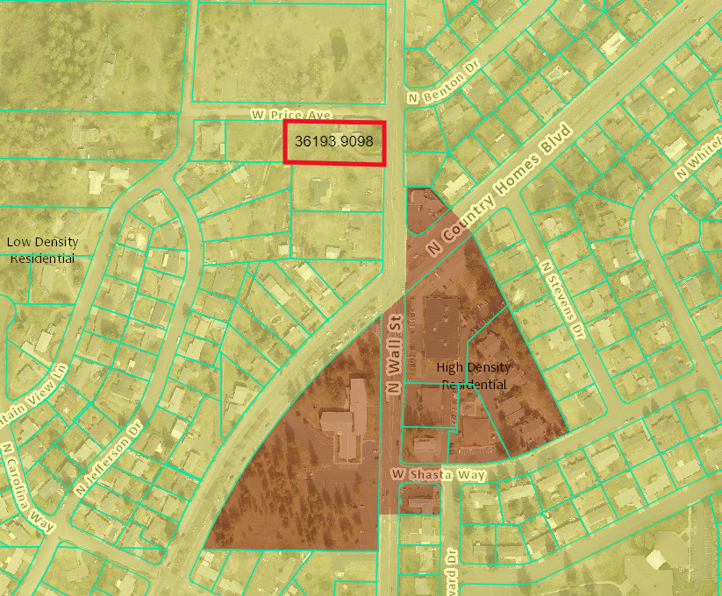
CPA-02-24
Site Location
Site Information
Request: LDR → HDR
Site Size: 0.82 Acres
North Metro Urban Growth Area
Access: North Wall Street
Spokane County wastewater
Whitworth Water
Mead Schools
Fire District 9
Spokane County Building & Planning

Slide 7
CPA-02-24
Site Location
Located in the County Homes area along North Wall Street and West Price Avenue. Whitworth University is located approximately one mile north of the subject property.
South of the subject property is HDR-designated parcels, including CPA-05-22, which was changed from LDR to HDR during the 2023 CPA cycle.
Population Impact
Spokane County Building & Planning
Notes:
This proposed amendment likely will satisfy SCC 14.402.040 (1) consistent with or implements the Comprehensive Plan and is not detrimental to the public welfare; and (2) change in economic, technological, or land use conditions has occurred to warrant modification

Slide 8
CPA-02-24
Critical Areas
The property has a high stormwater risk designation on about 5% of its western portion, but does not otherwise include any identified critical areas.
Nearby Amenities
Within a mile of the property are 2 parks, 2 bus stops, commercial areas and Whitworth University.
Spokane County Building & Planning

Slide 9
CPA-02-24
Public Comments
Concern | Response
Traffic | The applicant’s traffic letter, which was accepted by the Spokane County Public Works Department, showed no major impact to area arterials.
Water runoff | Staff has communicated with stormwater officials at the County, who stated that issues for construction of this site would require following Spokane County code.
Parking | If the parcel is developed as multi-family, it would require 1.5 parking spaces per units, plus 5% for guest parking. There are no on-street parking requirements.
Emergency vehicle access | Staff has no comment.
Safety | Staff is not aware of any connection between multi-family developments and crime rates.
Property values | Staff has no comment.
Spokane County Building & Planning

Slide 10
CPA-02-24
SEPA
An MDNS was issued for this project to address concerns stated by the Spokane Tribe, the Department of Archaeology and Historic Preservation, and the Whitworth Water District.
MDNS Conditions
Project must include an involuntary discovery plan
Property must be evaluated for inclusion in the National Registry of Historic Places.
The property owner must analyze the need for an improved water main and pay for the improvement, if deemed necessary
Spokane County Building & Planning

Slide 11
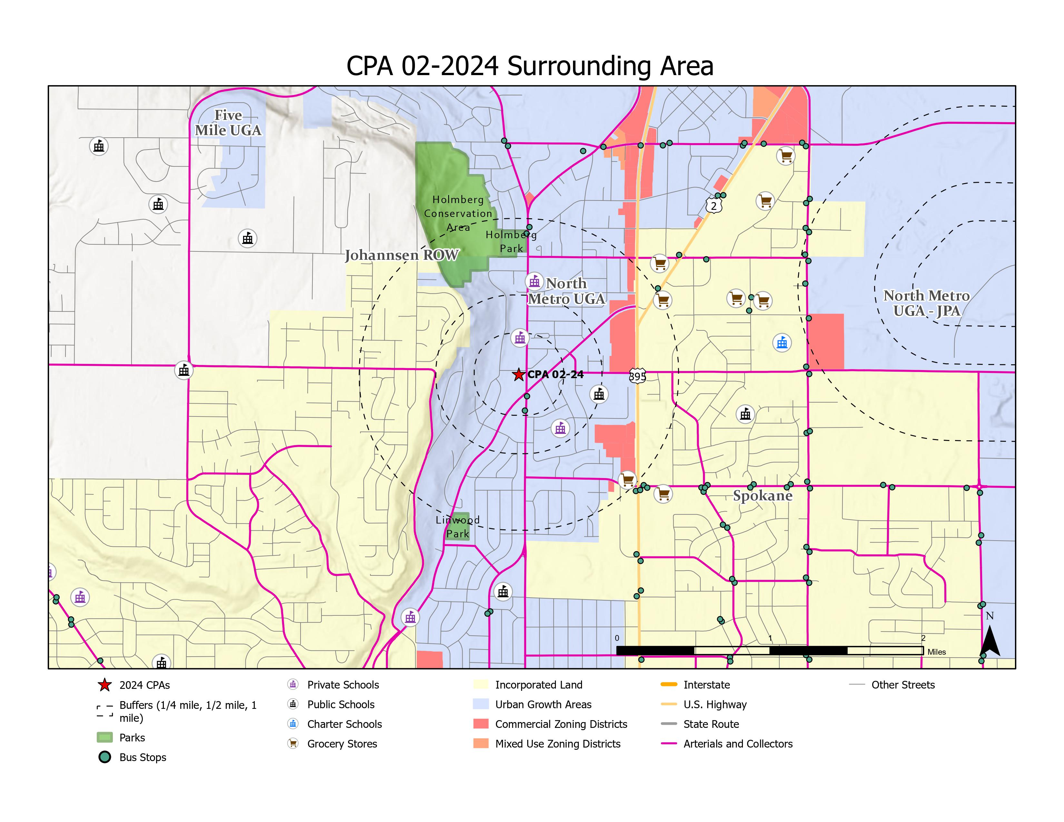
CPA-02-24
Spokane County Building & Planning

Slide 12
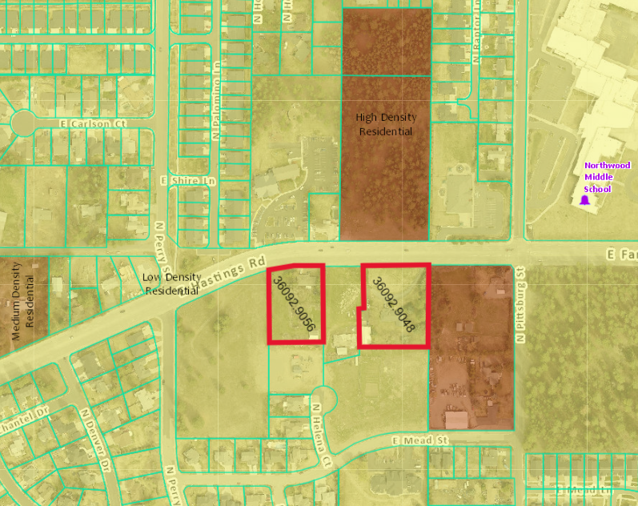
CPA-03-24
Site Location
Site Information
Request: LDR → HDR
2.97 acres
North Metro UGA
Access: Farwell/ Hastings
Water District 9
Spokane County Sewer
Mead Schools
Fire District 9
Spokane County Building & Planning
Notes:
This proposed amendment likely will satisfy SCC 14.402.040 (1) consistent with or implements the Comprehensive Plan and is not detrimental to the public welfare; and (2) change in economic, technological, or land use conditions has occurred to warrant modification

Slide 13
CPA-03-24
Site Description
Located along East Hasting Road and East Farwell Road in the Fairwood area. Access to the subject property is from East Hasting and East Farwell Roads, both public urban principal arterials. The current surrounding comprehensive planning and zoning designations include two lots directly across East Farwell Road designated HDR totaling 6.41 acres and to the east adjoining the subject property, a 4.18-acre parcel zoned HDR. Surrounding uses across East Farwell Road of the subject property include a church, preschool, Northwood Middle School, and the Farwell Elementary School.
Population Impacts
Spokane County Building & Planning

Slide 14
CPA-03-24
Critical Areas
Subject parcels are in a critical aquifer recharge area of high importance and a low-risk drainage area.
The Washington State Department of Fish and Wildlife had no concerns and described the parcels as not having any habitat features that meet the definition of shrubsteppe habitat.
Nearby Amenities
Three schools (Northwood Middle School, North Star School, and Farewell Elementary School are approximately a 0.5-mile northeast.
A cluster of mixed use/urban activity centers and regional commercial designations are approximately 0.85 miles west and 0.4 miles southeast.
Camelot Park and Freddies Natural Area are approximately 1 mile southwest.
Spokane County Building & Planning

Slide 15
CPA-03-24
Public Comments
No public comments were received at the time of report publication.
Spokane County Building & Planning

Slide 16
CPA-03-24
SEPA
An MDNS was issued based off the following agencies:
Spokane County Water District 3: stated that water system upgrades may be required. Spokane County shall not issue any building permits until water concurrency is provided to the satisfaction of Spokane County Water District 3
Spokane Tribe of Indians: An Inadvertent Discovery Plan shall be implemented into the scope of work at the time of development
Spokane County Public Works and the WSDOT: If the site is later developed to exceed the 15 PM peak hour trips proposed, additional traffic analysis shall be provided for review
Spokane County Building & Planning

Slide 17
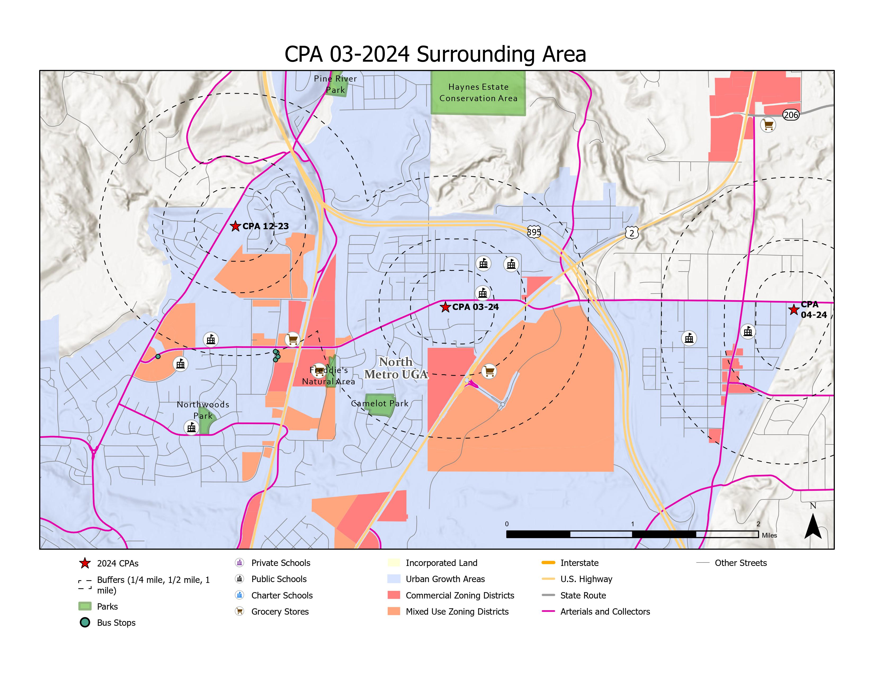
CPA-03-24
Spokane County Building & Planning

Slide 18
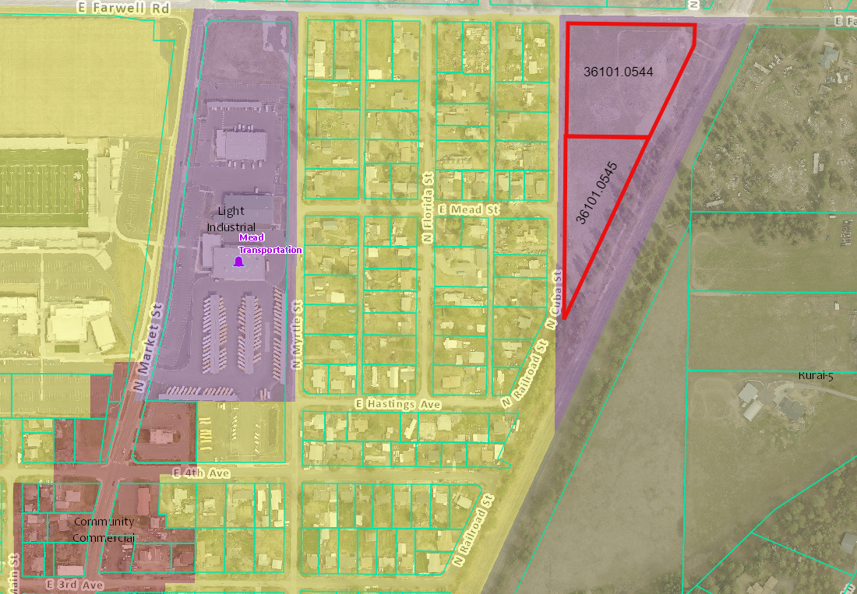
CPA-04-24
Site Location
Site Information
Request: LI → MDR
5.22 acres
North Metro UGA
Access: East Farwell
Water District 3
Spokane County Sewer
Mead Schools
Fire District 9
Spokane County Building & Planning
Notes:
This proposed amendment likely will satisfy SCC 14.402.040 (1) consistent with or implements the Comprehensive Plan and is not detrimental to the public welfare; and (2) change in economic, technological, or land use conditions has occurred to warrant modification

Slide 19
CPA-04-24
Site Description
Located in the Mead area along East Farwell Road, and North Cuba Street. The surrounding comprehensive plan zoning designations from the subject property include Urban Reserve to the north, Rural Traditional to the northwest, Rural-5 to the east, and Low-Density Residential to the west. To the west are Light Industrial and Community Commercial properties. Adjoining the eastern property line of the subject property is an active BNSF train track. Sewer service is not available at the subject parcels and will need to be installed prior to development.
Population Impact
Spokane County Building & Planning

Slide 20
CPA-04-24
Nearby Amenities
The CPA-04-2024 Surrounding Area map notes that the proposed
site is near commercial zoning. It is also between the quarter mile and half-mile radius boundaries of a public school and
within a half-mile and one-mile radius boundaries of another
public school. The project is also near low-density residential
and open spaces
Critical Areas
Critical Aquifer Recharge Area: High/Moderate.
Cultural Resources: High Probability
Stormwater Risk: Low
Spokane County Building & Planning

Slide 21
CPA-04-24
Public Comments
Comment | Response
Traffic | A trip generation letter was distributed to WSDOT and Spokane County Public Works. They have provided no further comment on the project.
Community Cohesion | Properly designed multi-family development fits into community cohesion/community character.
Safety | The Burlington Northerns Sante Fe line was provided with an opportunity to provide comment on the project during SEPA circulation and prior to SEPA circulation. BNSF has not provided comment on the proposed project.
Population Density | Spokane County staff has conducted a concurrency analysis for its capital facilities. Spokane County can serve the zone change without exceeding its Level of Service Standards.
Impact on Taxpayers | Comment Noted
Impact on Quality of Life | Comment Noted
Environmental Concerns | Relevant agencies have been notified including State of Washington Department of Fish and Wildlife, their comment stated that, “None of the parcels in the CPAs have habitat features that meet the definition of shrub steppe habitat. There were no other PHS features identified on the parcels in question”
Infrastructure Strain | Spokane County Planning Staff have created a concurrency analysis to ensure that the zone change will not exceed the capacity of our capital facilities. WSDOT and Spokane County Public Works have not demonstrated any concerns with the project. Staff can confirm that Spokane County can serve this zone change without exceeding the level of service standards. Spokane County Water District 3 has stated that Water System upgrades may be required. The developer must consult with Spokane Water District 3 and must be able to provide proof of concurrent water prior to permit issuance.
Property Value | Best planning practices do not suggest that siting multi-family development reduces neighborhood property values.
Spokane County Building & Planning

Slide 22
CPA-04-24
SEPA (Mitigated Determination of Nonsignificance)
Washington State Department of Archaeology & Historic Preservation
Requires a professional archeological survey of the project that shall be completed and submitted to DAHP before any ground-disturbing activities or before the issuance of any construction or grading permits.
Spokane County Water District 3
Spokane County Water District 3 has stated that water systems upgrades may be required. Spokane County shall not issue any building permits until water concurrency is provided to the satisfaction of Spokane County Water District 3.
Spokane County Public Works
Spokane County Public Works has clarified the proposed site does not have an active sewer service serving the proposed site. Additionally, Public Works indicated there is no sewer improvements planned for the proposed site in the current County six-year sewer plan. As per the development regulations/zoning code of the governing authority as amended projects that fall within the boundaries of the UGA are required to connect to a sanitary sewer system. No building permit shall be issued until the developer has demonstrated sewage concurrency to the satisfaction of Spokane County Public Works.
Spokane County Building & Planning

Slide 23
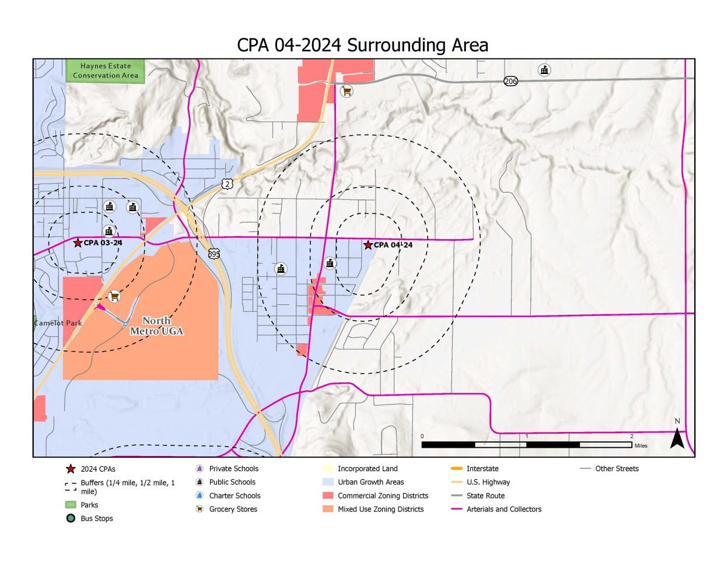
CPA-04-24
Spokane County Building & Planning

Slide 24
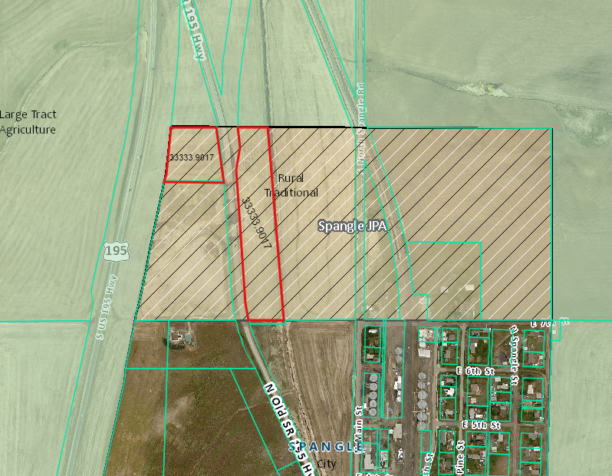
CPA-05-24
Site Location
Site Information
Request: RT → RC
11.5 acres
Spangle UGA
Access: U.S. 195
City of Spangle Water
City of Spangle Sewer
Liberty Schools
Fire District 3
Spokane County Building & Planning
Notes:
This proposed amendment likely will satisfy SCC 14.402.040 (2) change in economic, technological, or land use conditions has occurred to warrant modification; and (1) consistent with or implements the Comprehensive Plan and is not detrimental to the public welfare.

Slide 25
CPA-05-24
Site Description
Located north of Spangle along Old State Route 195 and the current US-195 Highway. The current surrounding comprehensive plan zoning designation is Large Tract Agriculture. The subject proposal is located in the Spangle joint planning area. The Spangle wastewater treatment plant is south of the western subject area. A designated Department of Natural Resource stream is on the easterly boundary portion of the proposal.
The site is unserved by urban services.
Spokane County Building & Planning

Slide 26
CPA-05-24
Critical Areas
The project area is in a low susceptibility zone of a critical aquifer recharge area. It is bordered by a stream (Spangle Creek) along its easterly side that could be a fish habitat. The project area along Spangle Creek, about 100-135 feet is in a 100-year floodplain.
Nearby Amenities
Nearly the entire city of Spangle is within a mile of this project site, meaning that visitors to the site would be close to Spangle’s two local restaurants, other local businesses and local park. All residents of Spangle live within a mile of the project site.
Spokane County Building & Planning

Slide 27
CPA-05-24
Public Comments
Comment | Response
GMA Compliance | This development will be subject to GMA compliance.
Environmental Concerns | Any development that occurs on the property will not be allowed within 100’ of Spangle Creek.
Traffic Concerns | WSDOT is requiring a traffic analysis and a trip distribution letter to be completed for this CPA.
Impacts on Utilities | This site will initially use a well and a septic system, as the Town of Spangle does not currently run water or sewer to the property. However, following the update of Spangle’s water plan, the property’s need for water and sewer connections will be reassessed. It should be noted that a letter from a legal representative of the Town of Spangle indicates that the Town has serious concerns about the applicant drilling a well on the property. However, legal representatives for the applicant have concluded that they may use an exempt well, which would mean they would not have to obtain a permit from the Department of Ecology before drilling.
Other (Impacts on Town of Spangle future growth, developer intentions, will there be more hearings, etc.) | This zone change will not in any way inhibit the future growth of Spangle. Developer has indicated that they intend to use the land for a variety of commercial uses (coffee stand, mercantile store, RV park, etc.) but none of these have been confirmed, nor will they be until the property is in the permitting stage of development. The next Planning Commission public hearing for CPA 05-24 will be on Sept. 12, 2024.
Spokane County Building & Planning

Slide 28
CPA-05-24
SEPA
An MDNS was issued for this project to address concerns stated by the Washington State Department of Transportation (WSDOT) and the Spokane Tribe of Indians.
MDNS Conditions
A limit on the number of trips to 33 AM Peak Hour trips and 27 PM Peak Hour trips, which are the maximum number of trips expected for this site, as described in the trip generation estimates letter provided by the applicant.
A requirement for further traffic analysis for any development that would generate trips above these thresholds in the future.
The inclusion of an inadvertent discovery plan in the project scope, to be provided for Spokane County Building & Planning before any ground-breaking activity.
Spokane County Building & Planning

Slide 29
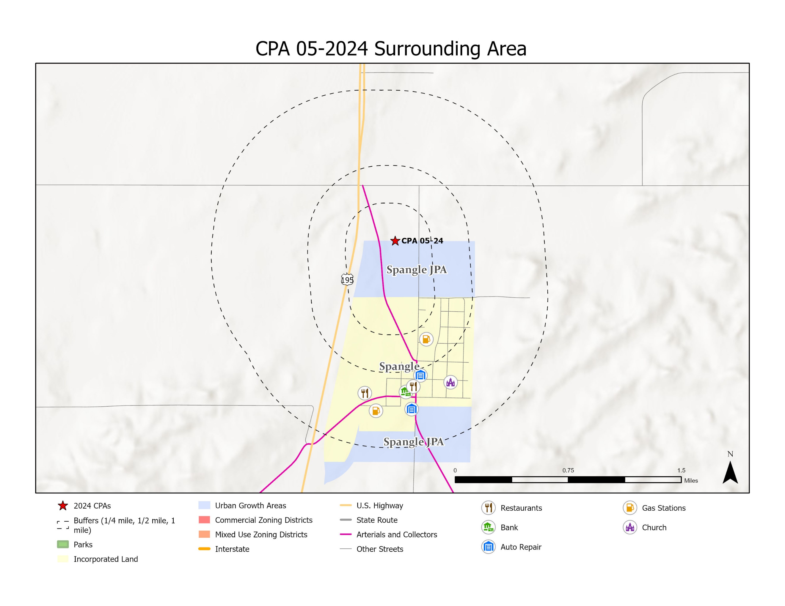
CPA-05-24
Spokane County Building & Planning

Slide 30
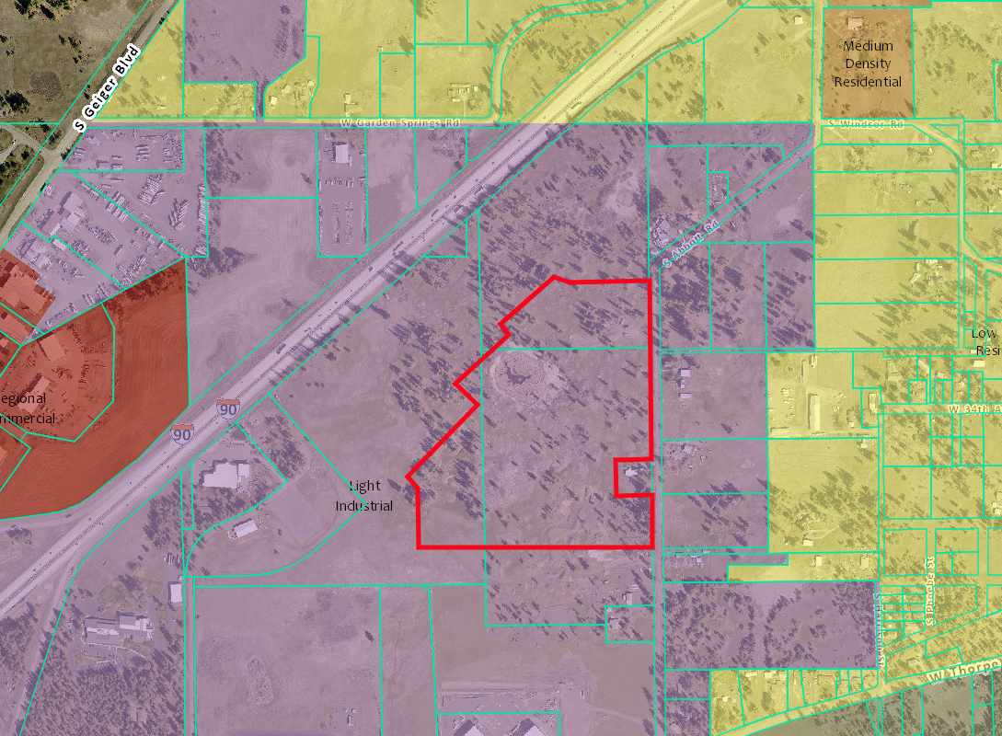
CPA-02-22
Site Location
Site Information
Request: LI → MU
±38 acres
West Plains/Thorp UGA
City of Spokane Water
City of Spokane Sewer
Cheney Schools
Fire District 10
Spokane County Building & Planning
Notes:
This proposed amendment likely will satisfy SCC 14.402.040 (1) consistent with or implements the Comprehensive Plan and is not detrimental to the public welfare; and (2) change in economic, technological, or land use conditions has occurred to warrant modification

Slide 31
CPA-02-22
Site Description
CPA-02 is located on the West Plains. The site is approximately 500 feet south of Interstate 90 and a ½ mile northeast of the Grove Road/I-90 interchange. The east side has a frontage on Abbott Road.
The site is substantially flat, with some rolling terrain, low-lying vegetation, and a scattering of pine trees. There are documented wetlands present on the site. Surrounding zoning designations include Low-Density Residential to the east, Rural-5 to the southeast, and Regional Commercial to the west.
Population Impacts
Spokane County Building & Planning

Slide 32
CPA-02-22
Critical Areas
The proposal is within a "moderate" critical aquifer recharge area, high-risk stormwater drainage area, an open space corridor and priority species site buffer, and has multiple wetlands on-site.
Nearby Amenities
The proposal is within a mile of existing commercial zoning.
Spokane County Building & Planning

Slide 33
CPA-02-22
Public Comments
One member of the public testified during the initiation phase before the planning commission, asking this project to be given a negative recommendation.
Spokane County Building & Planning

Slide 34
CPA-02-22
SEPA
A revised MDNS was issued for the proposal that modified conditions from WSDOT and the City of Spokane.
Modified Conditions: WSDOT
Potential improvements to the Geiger Interchange, Thorpe and US 195 intersection, will be funded with a proportionate share model
Potential pedestrian connections will be funded with a proportional share model
Modified Conditions: City of Spokane
Removed a $563,500 special connection charge
Spokane County Building & Planning

Slide 35
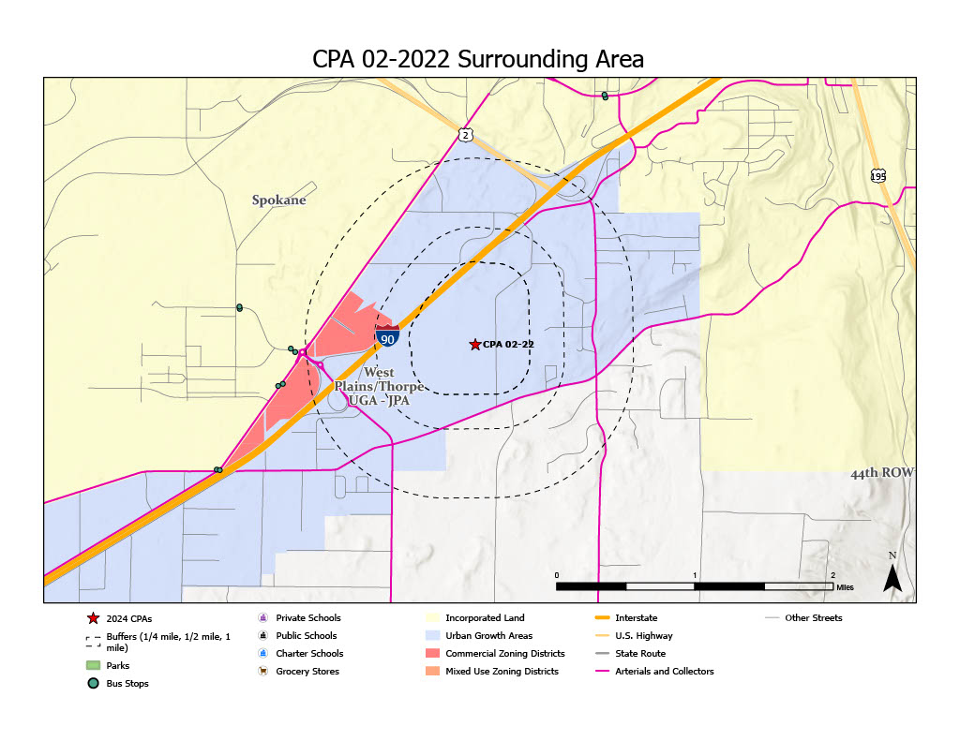
CPA-02-22
Spokane County Building & Planning

Slide 36
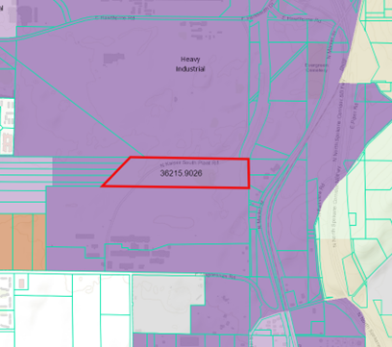
CPA-07-22 – withdrawn
Site Location
Site Information
Request: HI → RC
45.49 acres
North Metro UGA
Water – to be determined
Spokane County Sewer
Mead Schools
Fire District 9
Spokane County Building & Planning

Slide 37
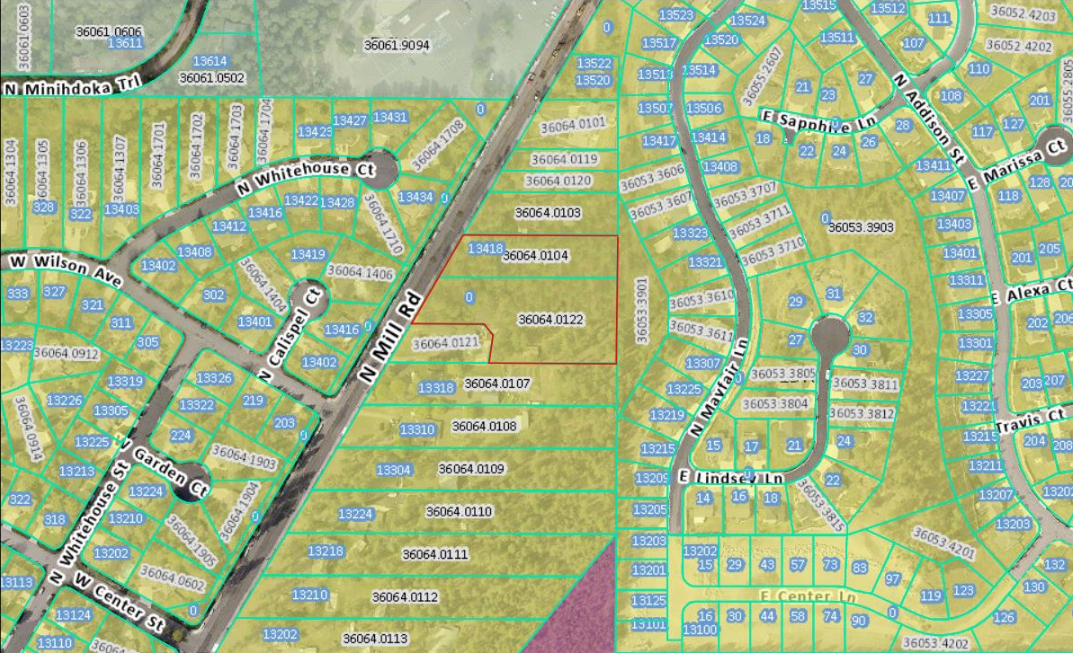
CPA-12-23
Site Location
Site Information
Request: LDR → MDR
2.64 Acres
North Metro UGA
Access: North Mill Road
Whitworth Water District
Spokane County Sewer
Mead Schools
Fire District 9
Spokane County Building & Planning
Notes:
This proposed amendment likely will satisfy SCC 14.402.040 (1) consistent with or implements the Comprehensive Plan and is not detrimental to the public welfare; and (2) change in economic, technological, or land use conditions has occurred to warrant modification.

Slide 38
CPA-12-23
Site Description
CPA-12-23 is between North Mill Road and North Mayfair Lane in the Fairwood area. The surrounding comprehensive plan zoning designations include Rural Conservation to the north, Urban Activity Center to the south and High-Density Residential to the southwest, approximately 0.33 miles away.
Access to the subject property is located along North Mill Road, designated as an Urban Principal Arterial.
Population Impacts
Spokane County Building & Planning

Slide 39
CPA-12-23
Critical Areas
The project area is in a moderate critical aquifer recharge area and a low-risk stormwater drainage area.
Nearby Amenities
There is an undeveloped mixed-use zone within a quarter mile of the project site. Commercial districts, a grocery store, transit stops, and a school are all within a mile of the site. There are more schools, parks and mixed-use areas within two miles of the site as well.
Spokane County Building & Planning

Slide 40
CPA-12-23
Public Comments
Comment Category | Response
Traffic | Traffic analysis and trip report showed that minimal impact to traffic would result from this CPA.
Wastewater Capacity | Spokane County Public Works did not issue any comment to the planning department regarding any concerns with wastewater capacity.
Increased Tax Assessments and Bonds | There is no way of knowing exactly how any new developments will impact property taxes, if at all.
Lack of Public Participation | Public participation process was extended by the Board of County Commissioners from 2023 to the 2024 cycle to reflect the concerns of citizens regarding this CPA last time it was considered.
Neighborhood Character | The comprehensive plan encourages upzoning of properties where appropriate in Urban Growth Areas. Given the location of this CPA on busy road near transit and other urban amenities, this seems like a good location for this kind of development.
Property Values | There is no empirical evidence that shows that multifamily development, or higher density development in general, leads to decreased property values for nearby properties.
Safety | Public Works and other agencies may ask the developer to employ mitigating measures to ensure pedestrian safety during the development stage.
Spokane County Building & Planning

Slide 41
CPA-12-23
SEPA
An MDNS was issued for this project to address concerns stated by the Washington State Department of Archaeology & Historic Preservation.
MDNS Conditions
Requires a cultural resource survey shall be completed and submitted to DAHP before any ground-disturbing activities or before the issuance of any construction of grading permits.
Spokane County Building & Planning

Slide 42
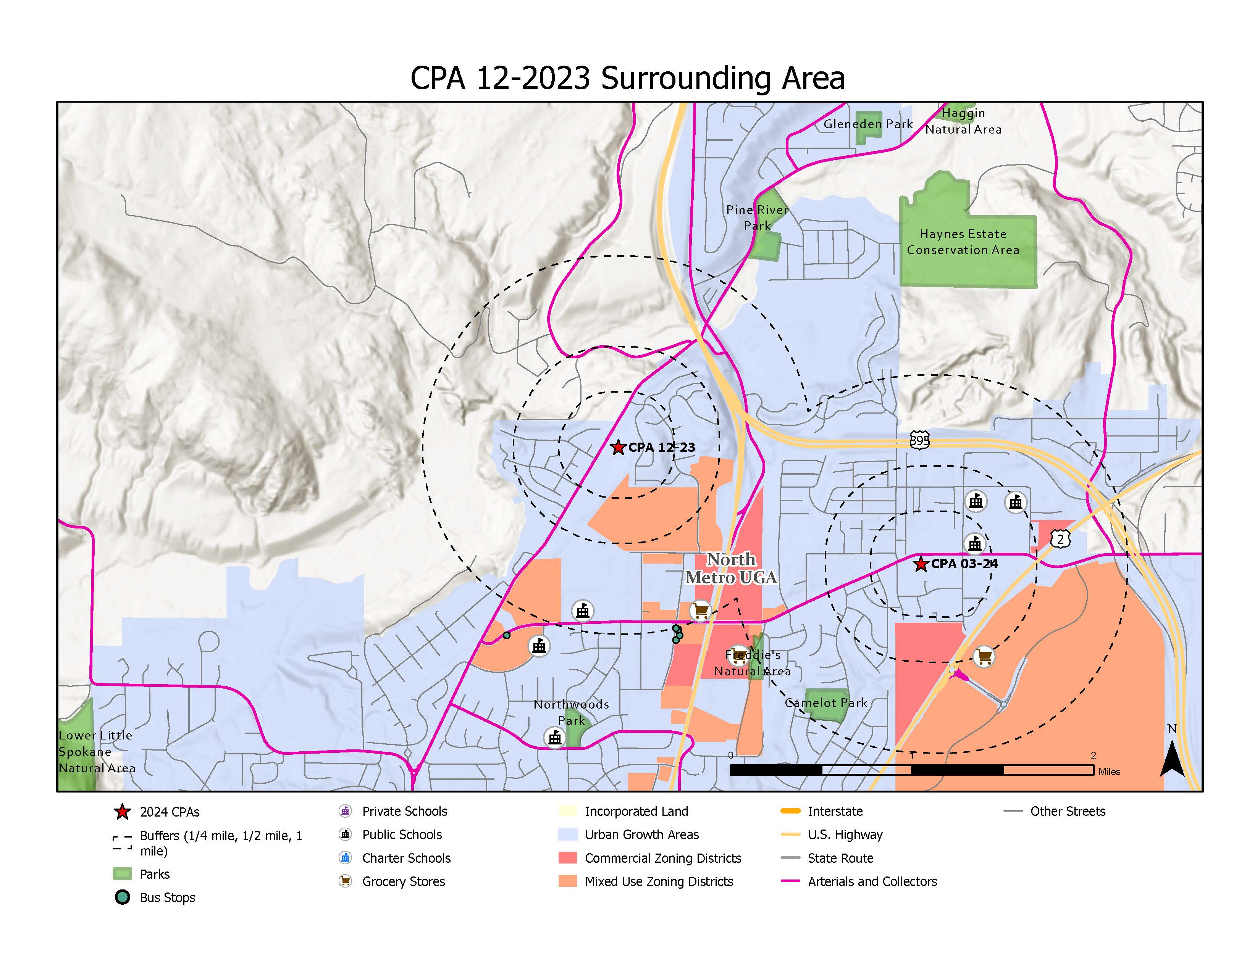
CPA-12-23
Spokane County Building & Planning

Slide 43
Cumulative Impacts – 2024 CPA Cycle
How are facility impacts analyzed?
Facility impact assumptions created for each proposed amendment involves using the adopted levels of service and the county’s site impact assumptions. The assumptions applied in this analysis are derived from the 2024 Spokane County CPA Population Impacts and Service Assumptions table, which is formulated to reflect the current development conditions and densities within Unincorporated Urban Growth Areas of Spokane County.
Each CPA’s population and unit potential are based on the maximum allowable buildout allowed under the proposed zoning. Further consideration for system capacity may also rely on the responses provided by facility staff and purveyors during the project circulation and request for comment phase.
Spokane County Building & Planning
Dwelling Units
Classification | Assumption
Low Density Residential | 4.43 dwelling units per acre
Medum Density Residential | 16.02 dwelling units per acre
High Density Residential | 24.25 dwelling units per acre
Mixed Use | 75% of MU area at 14.32 units per acre
Light Industrial | 0
Service and Facility Assumptions
Service or Facility | Assumption or Level of Service (LOS)
Libraries | 0.41 sf per capita
Parks | 1.4 acres of parkland per 1,000 persons
Schools | 0.5 students per residential unit
Law Enforcement | 1.01 officers per 1,000 persons
Wastewater | 100 GPD MF, 130 GPD MU, 175 GPD SF
Domestic Water | 180 GPD MF, 240 GPD MU, 590 GPD SF
Population Capacity
Dwelling Unit Type | Assumption
Single Family Residential | 2.5 residents per unit
Multi-family Residential | 1.5 residents per unit
Mixed Use | 2.0 residents per unit
Light Industrial | 0

Slide 44
Cumulative Impacts – 2024 CPA Cycle
Why analyze facility impacts?
By analyzing the facility impacts of the proposed amendments the county can accomplish the following
Concurrency with the Capital Facilities Plan
Ensure established levels of service will continue to be met
Assess the impacts of potential future growth from the original adoption of the comprehensive plan
Make informed decisions that account for the impact's amendments will have on our infrastructure and public services
Identify potential needed improvements
Provides an opportunity for collaboration between service providers and the county prior to development occurring
Spokane County Building & Planning

Slide 45
Cumulative Impacts – 2024 CPA Cycle
Conclusion of analysis
Through this effort of collaboration with facility and service providers, the county was able to identify potential impacts the amendments may have on our levels of service. In some circumstances, agencies were able to identify the necessary improvements needed for the proposals to remain within the established levels of service if full potential build-out was to occur.
Planning staff finds that adoption of these amendments to the 2020 Comprehensive Plan will not result in any degradation of the levels of service below the minimum established standards.
Spokane County Building & Planning

Slide 46
Timeline – 2024 CPA Cycle
December 20, 2023: Deadline for 2024 public CPA applications
January 11, 2024: Planning Commission pre-initiation workshop
February 15, 2024: Planning Commission review workshop
March 14, 2024: Planning Commission recommendation to initiate CPAs
April 23, 2024: BoCC initiation of 2024 CPAs
June 21, 2024: Agency review and comment period closes
August 29, 2024: Planning Commission CPA workshop
September 12, 2024: Planning Commission Public Hearing and recommendation
November 12, 2024: scheduled BoCC consideration of Comp Plan amendments
Spokane County Building & Planning

Slide 47
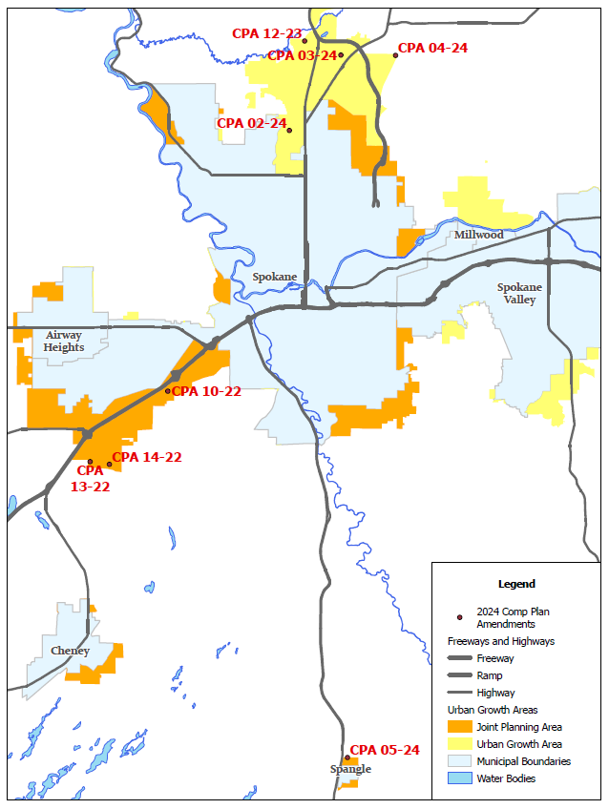
Comprehensive Plan Amendments 2024 Annual Review Cycle
Questions?
Spokane County Building & Planning

